Slide 1
MACHINE LEARNING

Slide 2
WHAT IS ML
Computer programs that uses algorithms to analyze data make intelligent predictions based
on the data without being explicity programmed.
Definition:
Machine Learning is the field of study that gives computers the ability to learn without
being explicity programmed – Arthur Samuel,1959

Slide 3
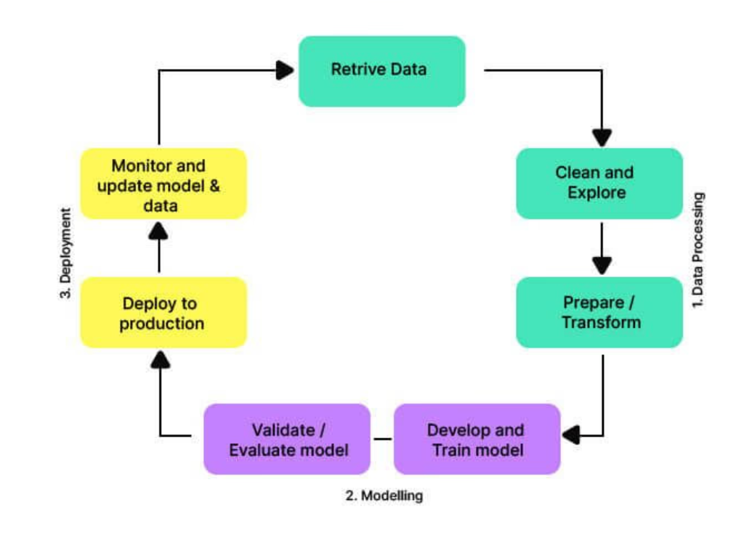
workflow

Slide 4
types
Categories into four:
ML
Supervised Learning
Unsupervised Learning
Semi-supervised Learning
Reinforcement Learning

Slide 5
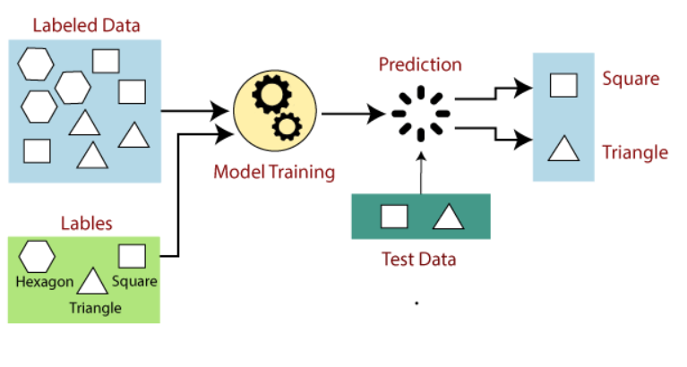
Supervised learning
In which the network is trained by providing it with input and matching output patterns.

Slide 6
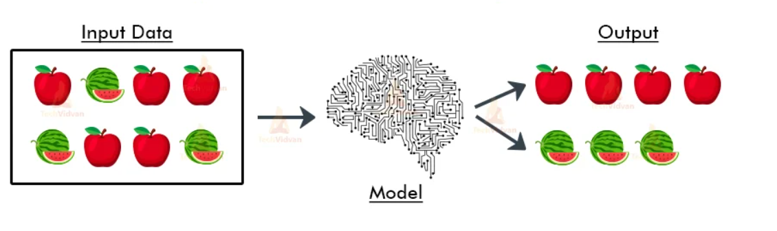
Unsupervised learning

Slide 7
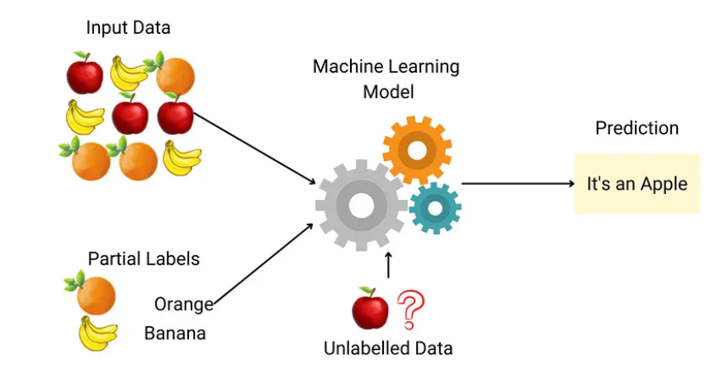
Semi-supervised learning

Slide 8
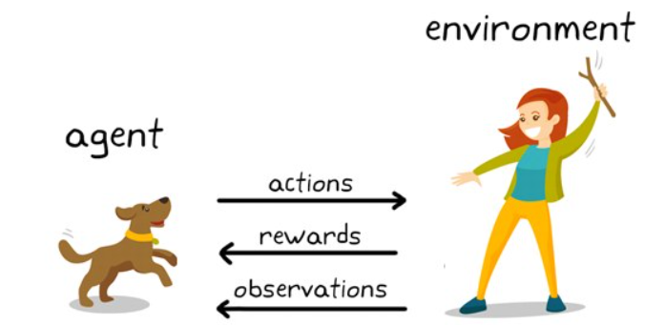
Reinforcement learning

Slide 9
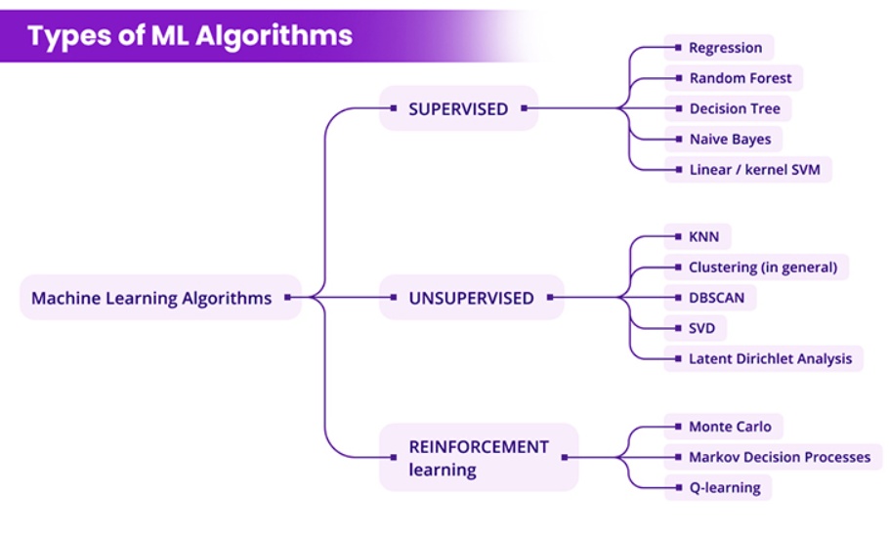
Algorithm

Slide 10
ApPlication
Healthcare: Disease prediction, personalized treatment.
Finance: Fraud detection, algorithmic trading.
Retail: Customer segmentation, recommendation systems.
Autonomous Vehicles: Self-driving cars, drone navigation.
Natural Language Processing (NLP): Language translation, sentiment analysis.

Slide 11
Challenges
Data Quality: Garbage in, garbage out.
Overfitting & Underfitting: Balancing model complexity.
Computational Resources: Need for powerful hardware.
Bias & Fairness: Ensuring ethical AI practices.

Slide 12
Future
Trends:
Increased use of deep learning.
Explainable AI (XAI) to understand model decisions.
Integration with IoT for smarter devices.
Emerging Technologies:
Quantum Computing and its potential impact on ML.

Slide 13
CONCLUSION
Machine Learning is a powerful subset of AI focused on training algorithms to make data-driven
decisions.
It encompasses various types, including supervised, unsupervised, and reinforcement learning,
each with distinct methodologies and applications.
Practical applications of ML span healthcare, finance, retail, autonomous vehicles, and natural
language processing, significantly impacting these fields.
Challenges like data quality, overfitting, computational requirements, and ethical consideratios
must be addressed for effective ML implementation.

Slide 14
THANK YOU

